Slide 1
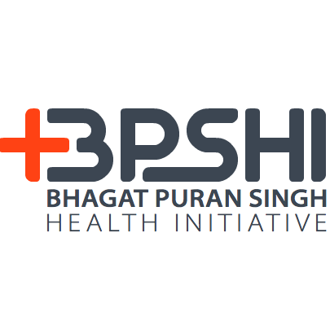
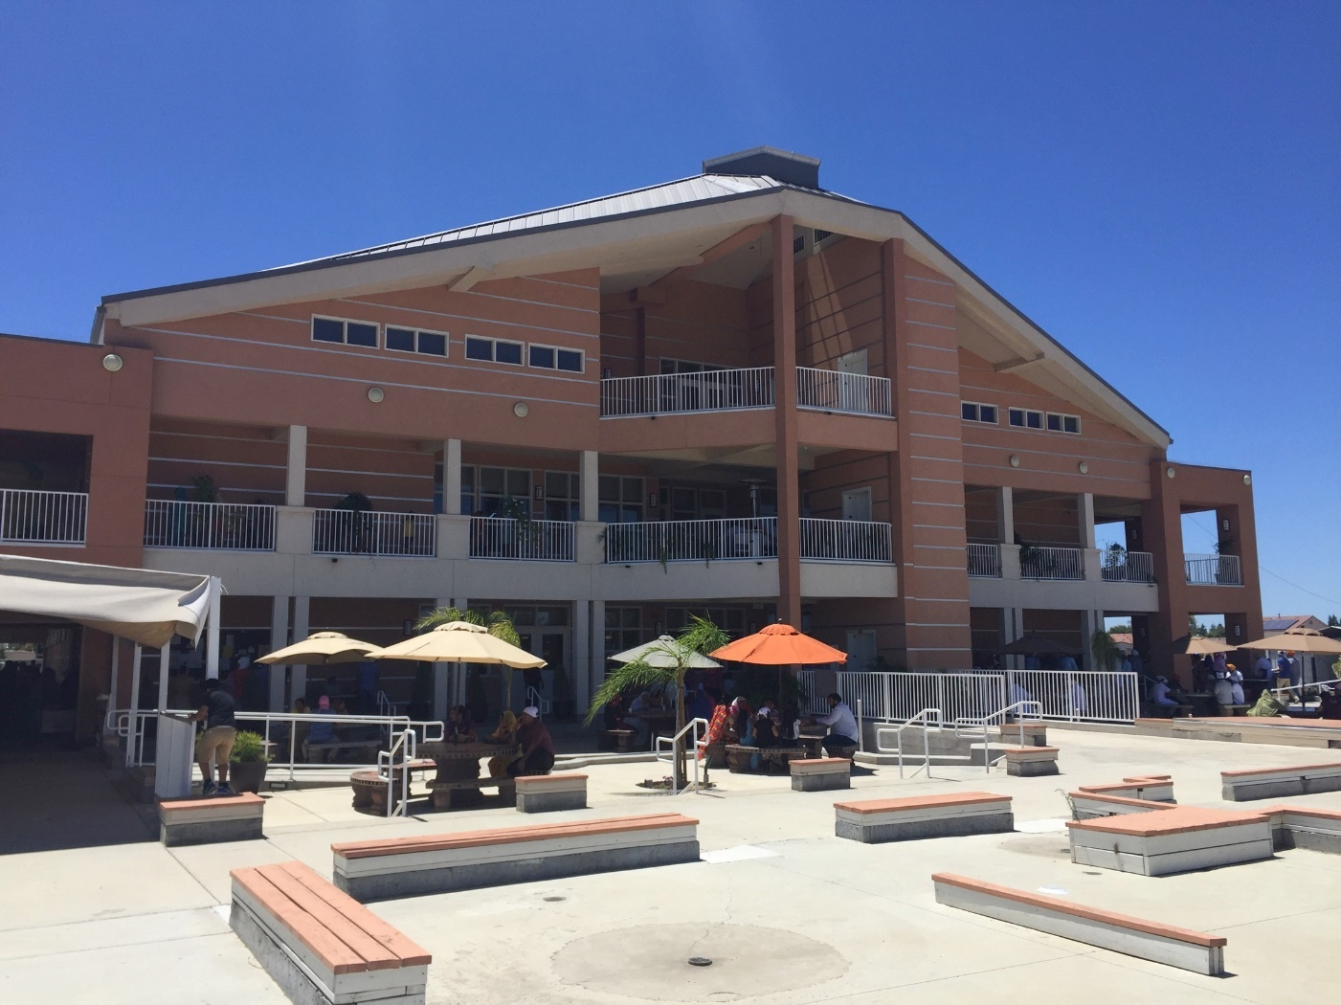
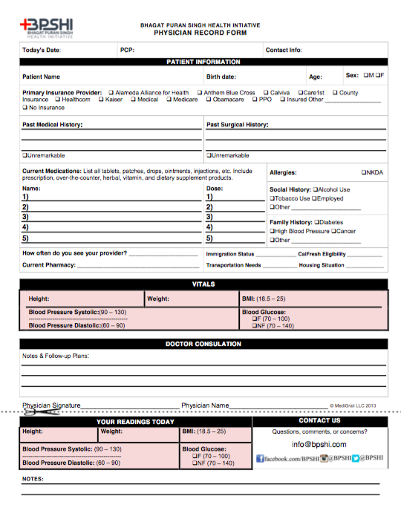
Diabetes and Hypertension Health Screening in the Fresno Sikh Population: A Cross Sectional Approach
Baljit Singh Dhesi ^{1,2}
¹University of California, Davis School of Medicine, Sacramento, CA, USA
²University of California, San Francisco-Fresno Medical Education, Fresno, CA, USA
Introduction
Methods
Results
Conclusions
Estimates put the Sikh Population at slightly north of five hundred thousand of the thirty eight million people in California. There is a gap of health awareness and research in the Sikh Community. This project aims to characterize the chronic disease burden in this population.
Bhagat Puran Singh Health Initiative is an organization that spans across multiple college campuses that serves to increase health awareness in the Sikh and local communities. For this project we partnered with the Fresno State BPSHI. Undergraduate volunteers run health education clinics and provide community service.
The members of the Sikh Fresno Temple were screened and educated for hypertension and diabetes at the Sikh Institute of Fresno on North Parkway Drive, Fresno CA.
Screenings were completed using manual blood pressure measurements and finger stick glucose levels.
Patients were screened over two days, 6/26/16 and 7/10/16 for a total of 97 patients, there were no other exclusion criteria.
Noted variables obtained from participants including fasting status, prior diagnosis and treatment, gender, and age.
Patients were screened for hypertension or diabetes using the criteria of blood pressure greater 140/90, or blood glucose >126 fasting and >200 non fasting.
Through our clinic we were able to screen positive two patients with hypertension and four patients with diabetes. Six new diagnoses in screening 97 patients total. (Figure 5)
When comparing screened patients + prior diagnosis of diabetes or hypertension to the general population it is noted that there are similar rates of hypertension in the patient population (30%) vs the general population (29.1%²). However when comparing screening for diabetes, the screening population was much higher (23.7%) vs the general population (13.0%¹). (Figure 6)
Figure 2: Gender Profile of Participants
Figure 3: Average Age among Participants and Subgroups
Discussion
For this cross sectional study we noted increased rates of diabetes in the testing population. This may implicate that the Sikh community may have a higher predisposition for developing diabetes. Conversely it may indicate environmental factors such as diet or health education may play a role. Healthcare providers can use this information to provide more aggressive screening for diabetes in Sikh patients.
Limitations of this study include limited variable analysis, limited statistical significance, lack of age stratification, and no control population with similar environmental factors. In the future we can incorporate more parameters such as BMI, have a control population to assess other environmental factors, and increase the number of patients in the study to add statistical significance and look for age variation.
Moving forward we can incorporate the results of this study to take into consideration of intervention programs in the Sikh community that can help alleviate the chronic disease burden including classes on exercise and diet. Overall this study will provide a great stepping stone for future studies.
Objectives
To conduct a cross sectional study on the prevalence of diabetes and hypertension in the members of the Fresno Sikh Temple
To get a greater understanding of chronic disease burden in the Sikh community
To provide health education on chronic metabolic diseases to the members of the Fresno Sikh temple
To partner with Fresno undergraduate students in the Bhagat Puran Singh Health Initiative organization at CSU Fresno to foster greater health education and resources to the community at large
To increase awareness of the Sikh culture in my fellow colleagues
Figure 4: Percent of Total Patients with prior diagnosis of Diabetes or Hypertension and those who screened positive.
Image 1: Fresno Sikh Institute.
Figure 1: Intake Form
Screening Population Demographics
Acknowledgements
Total Patients | 97
Mean Age | 53
Age Range | 21-82
Male Gender | 59 (60.8%)
Female Gender | 38 (39.2%)
Bhagat Puran Singh Health Initiative at Fresno State
Research Department at UCSF-Fresno Family & Community Medicine
Dr. Khaira and Dr. Chann
Figure 5: Hypertension and Diabetes Diagnosis in Participants vs General Population
References
Table 1: Patient Demographics
American Diabetes Association – Statistics. Accessed July 17, 2016. http://www.diabetes.org/diabetes-basics/statistics/
Nwankwo et al. Hypertension Among Adults in the United States: National Health and Nutrition Examination Survey, 2011–2012. NCHS Data Brief, October 2013, No 133.

